Slide 1

EEL 4781 Computer Communication Networks Chapter 2-2: Application Layer
Xin Xin
Department of Electrical and Computer Engineering
University of Central Florida

Slide 2
Agenda
Web
HTTP Protocol
HTTP Improvement
Web Caches
Email
SMTP Protocol
FTP (Optional) discussion only*

Slide 3

HTTP (continued)
Non-persistent HTTP: response time
RTT (Round Trip Time): time for a small packet to travel from client to server and back
HTTP response time (per object):
one RTT to initiate TCP connection
Why? Allocating resources?
one RTT for HTTP request and first few bytes of HTTP response to return
object/file transmission time
initiate TCP
connection
RTT
request file
RTT
time to
transmit
file
file received
time
time
Non-persistent HTTP response time = 2RTT+ file transmission time

Slide 4
HTTP - Protocol
HTTP overview (continued)
Identifier
IP and port number: 80
URL (Uniform Resource Locator)
Protocol
Format
Types
Services
Sockets
Challenges
Non-persistent (HTTP/1.0)
Stateless
Cookies
HTTP/1.0
HTTP/1.1
HTTP/2

Slide 5
HTTP - Protocol
HTTP request message
two types of HTTP messages: request, response
HTTP request message:
ASCII (human-readable format)
carriage return character
request line (GET, POST,
HEAD commands)
line-feed character
GET /index.html HTTP/1.1\r\n
Host: www-net.cs.umass.edu\r\n
User-Agent: Mozilla/5.0 (Macintosh; Intel Mac OS X 10.15; rv:80.0) Gecko/20100101 Firefox/80.0 \r\n
Accept: text/html,application/xhtml+xml\r\n
Accept-Language: en-us,en;q=0.5\r\n
Accept-Encoding: gzip,deflate\r\n
Connection: keep-alive\r\n
\r\n
header
lines
carriage return, line feed at start of line indicates end of header lines

Slide 6
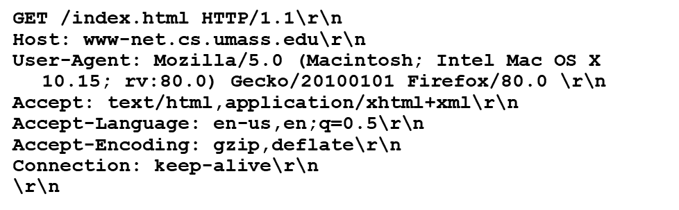
HTTP - Protocol
HTTP request message: general format
method
sp
URL
sp
version
cr
lf
request
line
header field name
value
cr
lf
~
~
header
lines
~
~
header field name
value
cr
lf
cr
lf
~
entity body
~
body
~
~

Slide 7
HTTP - Protocol
Other HTTP request messages
POST method:
Submit data to the server, usually to create or update a resource
user input sent from client to server in entity body of HTTP POST request message
HEAD method:
requests headers (only) that would be returned if specified URL were requested with an HTTP GET method.
PUT method:
uploads new file (object) to server
completely replaces file that exists at specified URL with content in entity body of POST HTTP request message
GET method :
Retrieve data from the server

Slide 8
HTTP - Protocol
HTTP response message
status line (protocol
status code status phrase)
HTTP/1.1 200 OK
Date: Tue, 08 Sep 2020 00:53:20 GMT
Server: Apache/2.4.6 (CentOS) OpenSSL/1.0.2k-fips PHP/7.4.9 mod_perl/2.0.11 Perl/v5.16.3
Last-Modified: Tue, 01 Mar 2016 18:57:50 GMT
ETag: "a5b-52d015789ee9e"
Accept-Ranges: bytes
Content-Length: 2651
Content-Type: text/html; charset=UTF-8
\r\n
data data data data data ...
header
lines
data, e.g., requested
HTML file

Slide 9
HTTP - Protocol
HTTP response status codes
status code appears in 1st line in server-to-client response message.
some sample codes:
200 OK
request succeeded, requested object later in this message
301 Moved Permanently
requested object moved, new location specified later in this message (in Location: field)
400 Bad Request
request msg not understood by server
404 Not Found
requested document not found on this server
505 HTTP Version Not Supported

Slide 10
HTTP - Improvement
Persistent HTTP (HTTP/1.1)
Non-persistent HTTP issues:
requires 2 RTTs per object
OS overhead for each TCP connection
browsers often open multiple parallel TCP connections to fetch referenced objects in parallel
Persistent HTTP (HTTP1.1):
server leaves connection open after sending response
subsequent HTTP messages between same client/server sent over open connection
client sends requests as soon as it encounters a referenced object
as little as one RTT* for all the referenced objects (cutting response time in half)
* Note that it still requires one RTT to establish connection for the first referenced object.

Slide 11
HTTP - Improvement
HTTP/2
HTTP1.1: introduced multiple, pipelined GETs over single TCP connection
server responds in-order (FCFS: first-come-first-served scheduling) to GET requests
with FCFS, small object may have to wait for transmission (head-of-line (HOL) blocking) behind large object(s)
HTTP/2: [RFC 7540, 2015] increased flexibility at server in sending objects to client:
methods, status codes, most header fields unchanged from HTTP 1.1
transmission order of requested objects based on client-specified object priority (not necessarily FCFS)
divide objects into frames, schedule frames to mitigate HOL blocking

Slide 12
HTTP - Improvement
HTTP 1.1: client requests 1 large object (e.g., video file) and 3 smaller objects
server
GET O₄
GET O₃
GET O₂
GET O₁
object data requested
client
O₁
O₂
O₁
O₂
O₃
O₃
O₄
O₄
objects delivered in order requested: O₂, O₃, O₄ wait behind O₁

Slide 13
HTTP - Improvement
HTTP/2: objects divided into frames, frame transmission interleaved
server
GET O₄
GET O₃
GET O₂
object data requested
GET O₁
client
O₂
O₄
O₃
O₁
O₂
O₃
O₄
O₁
O₂, O₃, O₄ delivered quickly, O₁ slightly delayed

Slide 14
HTTP - Improvement
Maintaining user/server state: cookies
Web sites and client browser use cookies to maintain some state between transactions
Example:
Susan uses browser on laptop, visits specific e-commerce site for first time
when initial HTTP requests arrives at site, site creates:
unique ID (aka “cookie”)
entry in backend database for ID
subsequent HTTP requests from Susan to this site will contain cookie ID value, allowing site to “identify” Susan

Slide 15
HTTP - Improvement
Maintaining user/server state: cookies
client
Amazon server
ebay 8734
usual HTTP request msg
Amazon server
creates ID
1678 for user
cookie file
usual HTTP response
set-cookie: 1678
create
entry
backend
database
ebay 8734
amazon 1678
usual HTTP request msg
cookie: 1678
cookie-
specific
action
access
usual HTTP response msg
one week later:
access
ebay 8734
amazon 1678
usual HTTP request msg
cookie: 1678
cookie-
specific
action
usual HTTP response msg
time
time

Slide 16
HTTP - Improvement
HTTP cookies: comments
aside
What cookies can be used for:
authorization
shopping carts
recommendations
user session state (Web e-mail)
cookies and privacy:
cookies permit sites to learn a lot about you on their site.
third party persistent cookies (tracking cookies) allow common identity (cookie value) to be tracked across multiple web sites
Privacy: Tracking a user’s browsing behavior
Challenge: How to keep state?

Slide 17

Web Caches
Web caches (aka proxy servers)
Goal: satisfy client requests without involving origin server
user configures browser to point to a (local) Web cache
browser sends all HTTP requests to cache
if object in cache: cache returns object to client
else cache requests object from origin server, caches received object, then returns object to client
Web
cache
HTTP request
HTTP request
client
HTTP response
HTTP response
origin
server
HTTP request
HTTP response
client

Slide 18
Web Caches
Web caches (aka proxy servers)
Web cache acts as both client and server
server for original requesting client
client to origin server
Browser caching - Conditional GET: keep info up-to-date
client: specify date of browser-cached copy in HTTP request
server: response contains no object if browser-cached copy is up-to-date
Benefits:
reduce response time for client request
reduce traffic on an institution’s access link
enables “poor” content providers to more effectively deliver content

Slide 19
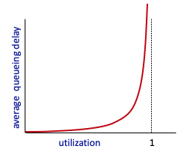


Caching example
Scenario:
access link rate: 1.54 Mbps
RTT from institutional router to server: 2 sec
web object size: 100K bits
average request rate from browsers to origin servers: 15/sec
avg data rate to browsers: 1.50 Mbps
origin
servers
public
Internet
1.54 Mbps
access link
Performance:
access link utilization = .97
LAN utilization: .0015
end-end delay = Internet delay +
access link delay + LAN delay
= 2 sec + minutes + usecs
problem: large queueing delays at high utilization!
institutional
network
1 Gbps LAN
Notes:
explain why minutes (recall earlier delay versus arrival rate curve from Chapter 1)

Slide 20
Option 1: buy a faster access link
Scenario:
access link rate: 1.54 Mbps
RTT from institutional router to server: 2 sec
web object size: 100K bits
average request rate from browsers to origin servers: 15/sec
avg data rate to browsers: 1.50 Mbps
154 Mbps
origin
servers
public
Internet
154 Mbps
1.54 Mbps
access link
Performance:
access link utilization = .97
LAN utilization: .0015
end-end delay = Internet delay +
access link delay + LAN delay
= 2 sec + minutes + usecs
.0097
institutional
network
1 Gbps LAN
Cost: faster access link (expensive!)
msecs
Notes:
t’

Slide 21
Option 2: install a web cache
Scenario:
access link rate: 1.54 Mbps
RTT from institutional router to server: 2 sec
web object size: 100K bits
average request rate from browsers to origin servers: 15/sec
avg data rate to browsers: 1.50 Mbps
origin
servers
public
Internet
1.54 Mbps
access link
Cost: web cache (cheap!)
institutional
network
Performance:
LAN utilization: .?
access link utilization = ?
average end-end delay = ?
1 Gbps LAN
How to compute link
utilization, delay?
local web cache
Notes:
t’

Slide 22
Calculating access link utilization, end-end delay with cache:
suppose cache hit rate is 0.4:
40% requests served by cache, with low (msec) delay
origin
servers
public
Internet
60% requests satisfied at origin
rate to browsers over access link
= 0.6 * 1.50 Mbps = .9 Mbps
access link utilization = 0.9/1.54 = .58 means low (msec) queueing delay at access link
1.54 Mbps
access link
institutional
network
average end-end delay:
= 0.6 * (delay from origin servers)
+ 0.4 * (delay when satisfied at cache)
= 0.6 (2.0) + 0.4 (~msecs) = ~ 1.2 secs
1 Gbps LAN
local web cache
lower average end-end delay than with 154 Mbps link (and cheaper too!)
Notes:
t’

Slide 23
Agenda
Web
HTTP Protocol
HTTP Improvement
Web Caches
Email
SMTP Protocol
FTP (Optional) discussion only*

Slide 24
E-mail - Overview
user
agent
Three major components:
user agents
mail servers
simple mail transfer protocol: SMTP
User Agent
a.k.a. “mail reader”
composing, editing, reading mail messages
e.g., Outlook, iPhone mail client
outgoing, incoming messages stored on server
mail
server
user
agent
SMTP
mail
server
user
agent
SMTP
SMTP
user
agent
mail
server
user
agent
user
agent
outgoing
message queue
user mailbox

Slide 25
E-mail - Overview
user
agent
mail servers:
mailbox contains incoming messages for user
message queue of outgoing (to be sent) mail messages
SMTP protocol between mail servers to send email messages
client: sending mail server
“server”: receiving mail server
mail
server
user
agent
SMTP
mail
server
user
agent
SMTP
SMTP
user
agent
mail
server
user
agent
user
agent
outgoing
message queue
user mailbox

Slide 26
SMTP - Protocol
SMTP RFC (5321)
“client”
SMTP server
“server”
SMTP server
uses TCP to reliably transfer email message from client (mail server initiating connection) to server, port 25
direct transfer: sending server (acting like client) to receiving server
three phases of transfer
SMTP handshaking (greeting)
SMTP transfer of messages
SMTP closure
command/response interaction (like HTTP)
commands: ASCII text
response: status code and phrase
initiate TCP
connection
RTT
TCP connection
initiated
220
SMTP handshaking
HELO
250 Hello
SMTP transfers
time

Slide 27
SMTP - Protocol
Mail message format
SMTP: protocol for exchanging e-mail messages, defined in RFC 5321 (like RFC 7231 defines HTTP)
RFC 2822 defines syntax for e-mail message itself (like HTML defines syntax for web documents)
header lines, e.g.,
To:
From:
Subject:
these lines, within the body of the email message area different from SMTP MAIL FROM:, RCPT TO: commands!
Body: the “message” , ASCII characters only
header
blank
line
body

Slide 28
SMTP - Protocol
Sample SMTP interaction
“client”
SMTP server
“server”
SMTP server
S: 220 hamburger.edu
C: HELO crepes.fr
S: 250 Hello crepes.fr, pleased to meet you
C: MAIL FROM: <alice@crepes.fr>
S: 250 alice@crepes.fr... Sender ok
C: RCPT TO: <bob@hamburger.edu>
S: 250 bob@hamburger.edu ... Recipient ok
C: DATA
S: 354 Enter mail, end with "."
C: Do you like ketchup?
C: How about pickles?
C: .
S: 250 Message accepted for delivery
C: QUIT
S: 221 hamburger.edu closing connection
initiate TCP
connection
RTT
TCP connection
initiated
220
SMTP handshaking
HELO
250 Hello
SMTP transfers
time

Slide 29


SMTP - Protocol
Scenario: Alice sends e-mail to Bob
1) Alice uses UA to compose e-mail message “to” bob@someschool.edu
4) SMTP client sends Alice’s message over the TCP connection
2) Alice’s UA sends message to her mail server using SMTP; message placed in message queue
5) Bob’s mail server places the message in Bob’s mailbox
3) client side of SMTP at mail server opens TCP connection with Bob’s mail server
6) Bob invokes his user agent to read message
user
agent
mail
server
user
agent
1
mail
server
2
3
4
6
Alice’s mail server
5
Bob’s mail server

Slide 30
SMTP - Protocol
Retrieving email: mail access protocols
user
agent
SMTP
SMTP
e-mail access
protocol
user
agent
(e.g., IMAP, HTTP)
sender’s e-mail
server
receiver’s e-mail
server
SMTP: delivery/storage of e-mail messages to receiver’s server
mail access protocol: retrieval from server
IMAP: Internet Mail Access Protocol [RFC 3501]: messages stored on server, IMAP provides retrieval, deletion, folders of stored messages on server
POP3: Post Office Protocol—Version 3
HTTP: gmail, Hotmail, Yahoo!Mail, etc. provides web-based interface on top of STMP (to send), IMAP or POP or HTTP to retrieve e-mail messages

Slide 31
SMTP: observations
comparison with HTTP:
HTTP: client pull (in most cases)
SMTP: client push
both have ASCII command/response interaction, status codes
HTTP: each object encapsulated in its own response message
SMTP: multiple objects sent in multipart message
SMTP uses persistent connections
SMTP requires message (header & body) to be in 7-bit ASCII
SMTP server uses CRLF.CRLF to determine end of message

Slide 32
Thanks
Acknowledgment
The materials for this course are in part based upon the materials from a number of people/sources, including:
Official website of the Kurose and Ross text: Computer Networking: A Top-Down Approach
Official website of the Tanenbaum & Wetherall text: Computer Networks
Dr. Murat Yuksel: https://www.ece.ucf.edu/~yuksem/teaching/EEL-4781-Fall-2020.html
Dr. Raj Jain: https://www.cse.wustl.edu/~jain/

Slide 33
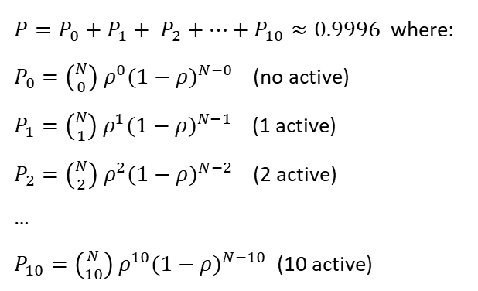
Recap
Network Core
Two key functions:
Two ‘switching’ strategies:
Packet-switching:
store-and-?
an important example
Some terms: ISP, CPN
Protocols
Five layers
Encapsulation
Security
packet “sniffing”:
IP spoofing: send packet with false source address
Denial of Service (DoS)

Slide 34
Recap
Network Core
Two key functions: Forwarding and Routing
Two ‘switching’ strategies: circuit-switching vs packet-switching
Packet-switching:
store-and-forward
an important example
Some terms: ISP, CPN
Protocols
Five layers
Encapsulation
Security
packet “sniffing”:
IP spoofing: send packet with false source address
Denial of Service (DoS)

Slide 35
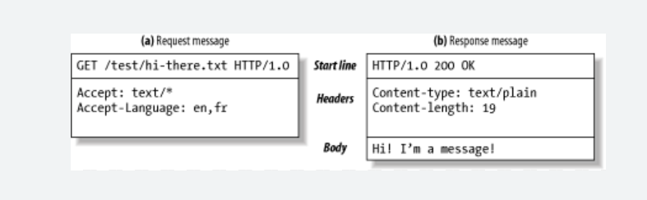
Recap
Application Layer
Two paradigms:
3 dimensions:
Identifier:
Interface of services:
Protocol: HTTP, SMTP…
Two services:
HTTP (HyperText Transfer Protocol)
Paradigm:
Service:
Format
Request:
Response
Features:
Non-persistent vs Persistent: how many RTTs
Stateless vs Stateful:
Transport Layer: 3-35

Slide 36
Recap
Application Layer
Two paradigms: server-client, peer-to-peer
3 dimensions:
Identifier: IP address and port number
Interface of services: Socket
Protocol: HTTP, SMTP…
Two services: TCP, UDP
HTTP (HyperText Transfer Protocol)
Paradigm: S-C
Service: TCP
Format
Request: GET, HEAD, POST, PUT (pull or push?)
Response
Features:
Non-persistent vs Persistent: how many RTTs
Stateless vs Stateful: cookies
Transport Layer: 3-36

